Slide 1

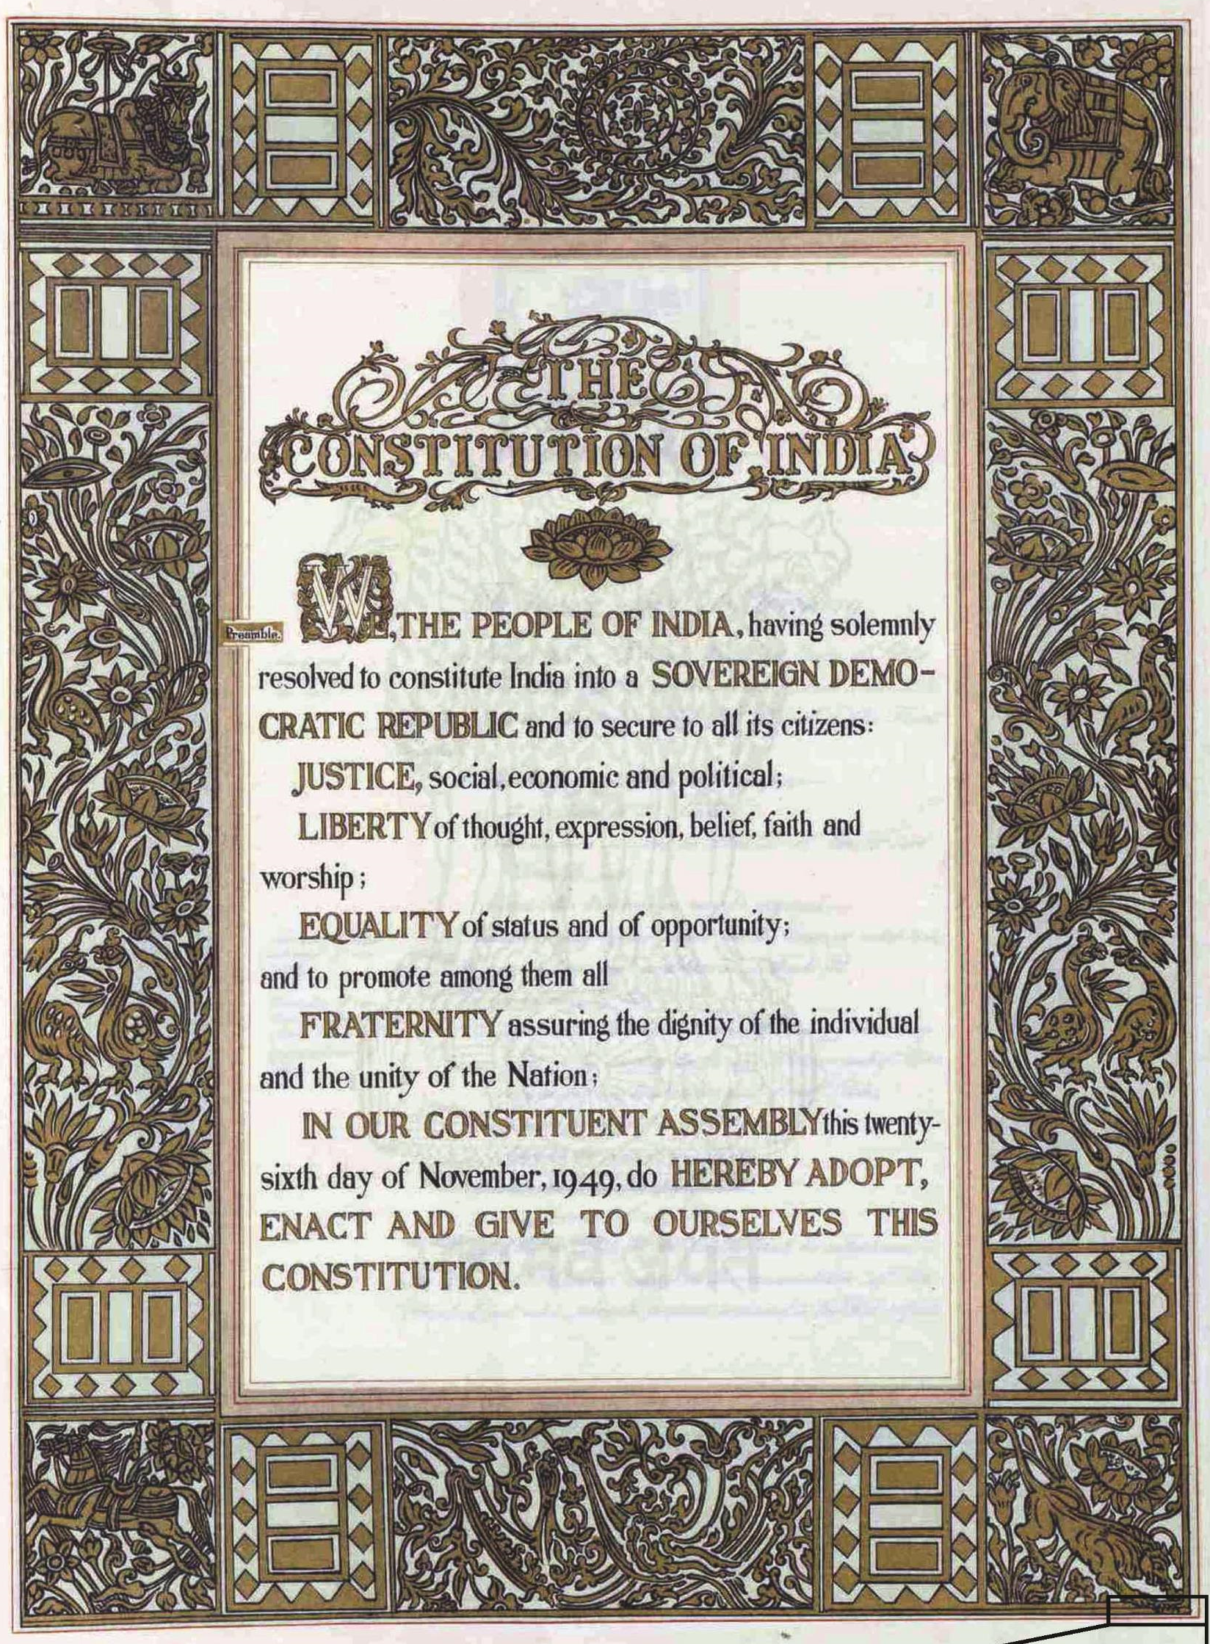
The Right To Freedom
Karnataka
CBL Project
Group 1
Aarush, Anjali, Deeptarka & Saanvi

Slide 2









Points to be covered by Group 1
What is the meaning of The Right To Freedom, with respect to the People of The Republic of India?
To infer the practical use of The Right To Freedom, with the help of a case study, related to Karnataka.
How has Karnataka been impacted by the Pandemic?
Why should Health Care be made a fundamental right?
Our main takeaways from The CBL Project.

Slide 3
What is Right to Freedom?
Defining Characteristics of Right to Freedom
Freedom Of Speech & Expression – We are free to speak and express opinions.
Freedom to assemble & form associations/unions/cooperative societies – We are free to form associations, unions and clubs. They are also free to assemble.
Freedom to move freely & Freedom of residence – We can settle anywhere and can move from state to state.
Freedom of profession – We are free to choose our own occupation.
Restrictions Which Can Be Imposed
Freedom Of Speech & Expression – We have the right to speak but not to abuse anyone.
Freedom to assemble & form associations/unions/cooperative societies – We can assemble peacefully so that we don't create chaos and havoc. But when we start violence, we violate the law.
Freedom to move freely & Freedom of residence- We have the right to settle anywhere but we can’t live on government property until allowed to do so.
Freedom of profession – We have the right to choose our occupations, but the government can set a standard and necessary qualifications for the job without which you can’t be employed for it.
In short, restrictions help in safeguarding sovereignty and unity of the country.

Slide 4
The Right to freedom has been stipulated in the Articles 19, 20, 21A & 22, as follows -
Article | Brief Description
Article 19 | Protection of 6 rights & it includes – Speech & Expression Assembly Association Movement Residence Profession
Article 20 | Protection with respect to conviction for offences
Article 21 | Right to life & personal liberty
Article 21A | Right to elementary education
Article 22 | Protection against arrest and detention in certain cases

Slide 5

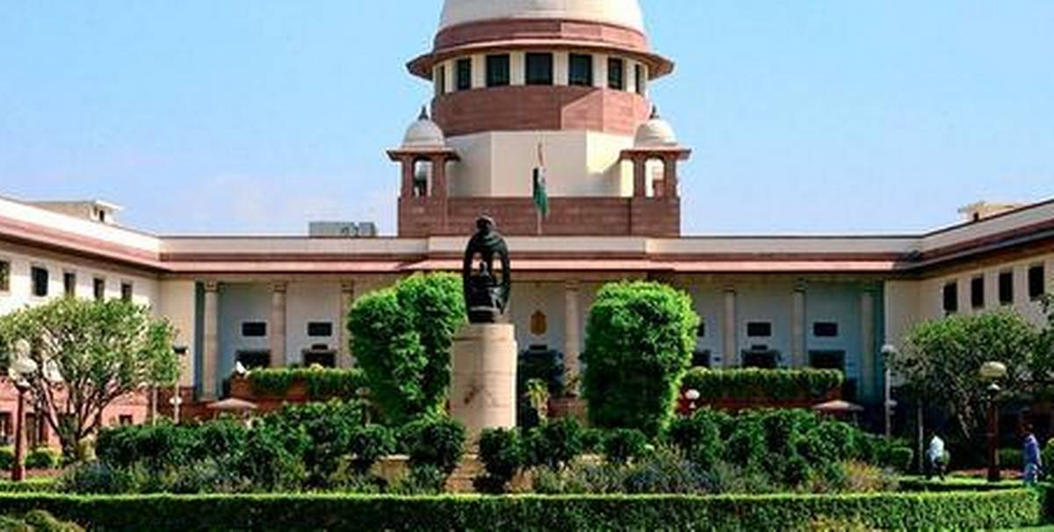
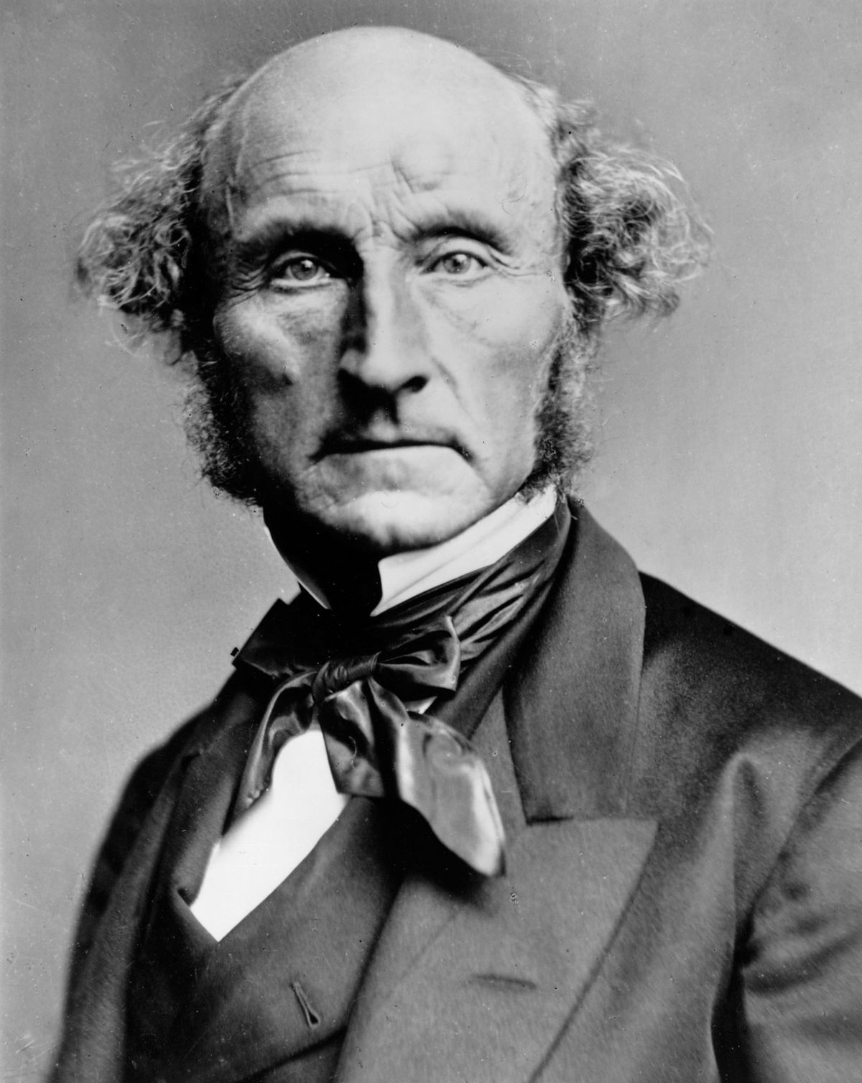
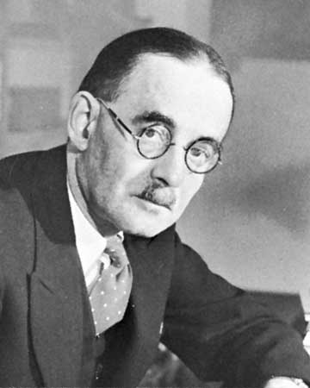
- Case Study - Karnataka v. Associated Management of English Medium Primary & Secondary Schools
On April 29, 1994, the Karnataka government issued a Government Order regarding language policy to be followed in primary and high schools for the academic year 1994-1995.
It stated that the primary and secondary schools should teach either in Kannada or the child's mother tongue. Unauthorized schools found violating this policy would be shut down.
The Associated Management of Primary and Secondary Schools in Karnataka challenged this order before the Karnataka High Court. That Court found this policy violates Articles 19(1)(g), 26 and 30(1) of the Constitution of India. On appeal before the High Court, the case was referred to the Supreme Court.
The Supreme Court then gave the verdict in favor of the management.
While giving the verdict, the most important issue dealt with the choice of a student/parent to choose a medium of instruction at primary education.
The Court held that the word freedom in Article 19 means absence of control by the State, thereby affording the liberty to choose, subject only to the enumerated restrictions under Article 19(2)-(6).
The Court cited the common ground reached by thinkers like John Stuart Mill and Harold J. Laski on the significance of liberty, to hold ultimately that “choice in the matter of speech and expression is absolutely necessary for an individual to develop his personality in his own way.
The Court expressly rejected the argument that the State may regulate the medium of instruction if it believes that it will be more beneficial to the child, siding on the lines of liberty of choice.
Thus, the verdict was given in favor of the management.

Slide 6

Impact of Pandemic on Karnataka
The growth of Karnataka’s economy has been drastically reduced by the Impact of the Pandemic
The healthcare system of Karnataka is one of the best, yet The Rural Sections of the society faced the most problems during The Second Wave, as connectivity continues to be a major issue in Shiggaon, etc.
Agriculture has also been affected by a great extent, since it is being reported that due to the fear of contacting the virus, farmers have stopped hiring labourers.
Due to this, unemployment rate has risen to its highest in years, if not decades, to 29.8%
Education has again faced a big setback, as the NEP [National Education Policy] will now only be implemented by 2022-23.
Karnataka’s Tourism Industry has also come to a grinding halt, as Hotels face a labour shortage, airlines make losses due to passenger shortage, etc.
However, The steps taken by the government are bringing the state on the right path.

Slide 7

Why should health care be made a fundamental right?
The pandemic in many ways as highlighted the significance and need of a robust public healthcare system in our country.
Everyone in India must have easy access to quality healthcare services at nominal prices.
If healthcare is made a fundamental right, it will act as the backbone of our entire health ecosystem
Additionally, it will help facilitate special legislation, establish efficient institutions, have increased budgets for medical training and research, emphasis on wellness and prevention, and outreach of services.
There must be a fundamental shift in our view on health care.
Even while we jostle to deal with the colossal health crisis amid the crumbling healthcare system, the grave economic impact of the crisis is for us to see.
Therefore, we need a very good disease surveillance; we need a unified primary care system that can deliver in the field. We need tertiary care with the most sophisticated of ventilators. And we need to increase capacity - an excess redundant capacity that can take care of any health emergency that happens.
But, The Constitution Of India Has Made References To Right To Health In Several Articles.

Slide 8
Our main takeaways from The CBL Project
The Right To Freedom [Articles 19-22] is important for the functioning of democracy.
Right to Freedom gives the Freedom Of Speech & Expression, Move & Assemble Freely, etc.
Restrictions may be imposed on various freedoms granted by this right, mainly to maintain the unity & sovereignty.
The Right to Freedom and the freedoms provided by it hold great significance, and this was realised by the curbs imposed on these due to the pandemic.
The devastating impact that the pandemic has had on Karnataka
The Right to healthcare should be made a fundamental right, as it will empower India’s healthcare system

Slide 9


We’re now open for questions!
Please raise your hand if you have any question & unmute, Only when asked to speak.

Slide 10



Thank You!

